Slide 1


Andrew Doberstein
Abhiram Muddu
Jimmy Ma
Utsav Vakil

Slide 2

Abhiram
Muddu
Jimmy
Ma
Utsav
Vakil
Andrew
Doberstein

Slide 3


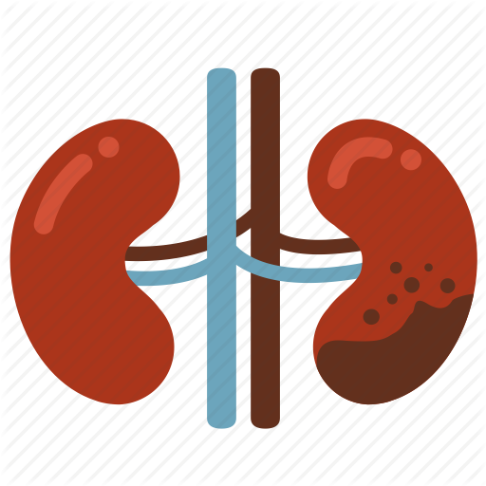




Diseases such as diabetes, liver cirrhosis, kidney disorders, and urinary tract infections are painful and expensive for both patients and their insurance providers.

Slide 4



In many cases these diseases aren’t treated until they’ve become catastrophes. What if we could make early symptom detection the default for the ‘at-risk’ population?

Slide 5
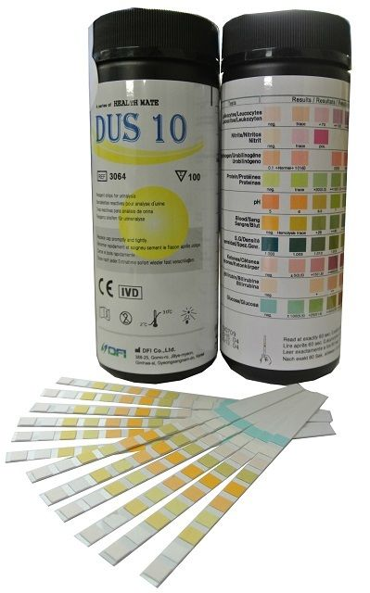

Urine tests can accurately detect disease symptoms, but aren’t widely used because they aren’t convenient enough.

Slide 6



$???M
If symptom detection tests were more widespread, we could catch millions of cases in the early stages, saving hundreds of millions in healthcare costs.

Slide 7

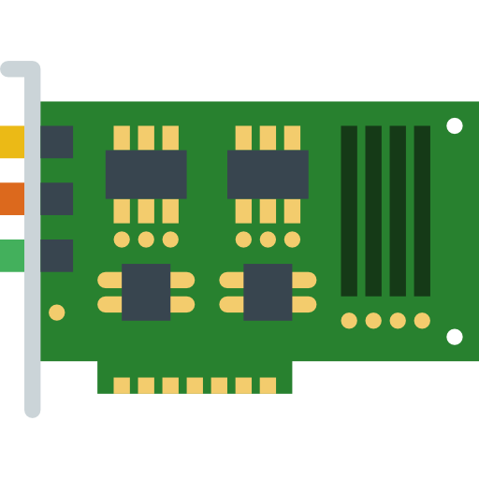


Our proposed device would detect symptoms every time you use the toilet and automatically notify your doctor with any problems.

Slide 8



Insurance Company
Disease / Medical Issue
Insured Person
Medical Care
Claim
Medical Provider
Symptoms
Engagement
Convenience
Frequency

Slide 9
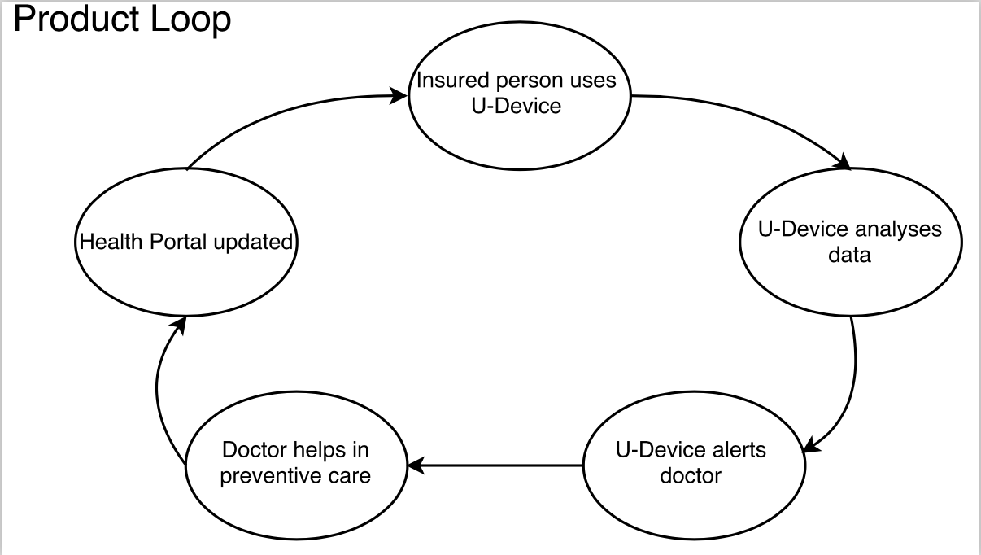

Slide 10

Mounting hook
Resistant Coating
Access Panel
Case
Battery
Motor
Chip / Board
Strip Supply/Loader
LED
Optical Sensor
Wireless Transmitter
In-home device
Strips/Testing Chemicals
Testing Chamber
Intake Pump
Toilet Water
Filter

Slide 11
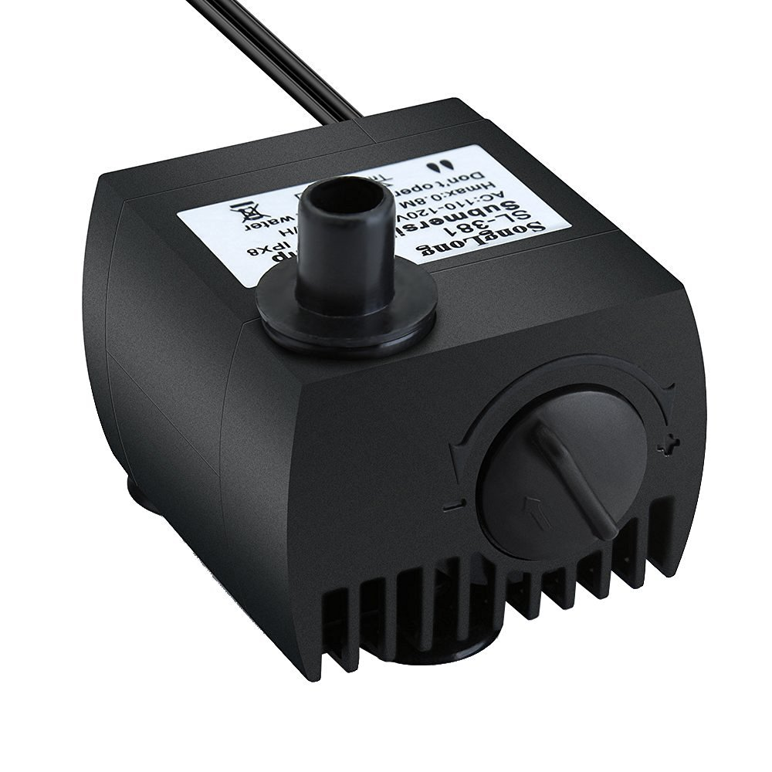
Mounting hook
Resistant Coating
Access Panel
Case
Battery
Motor
Chip / Board
Strip Supply/Loader
LED
Optical Sensor
Wireless Transmitter
In-home device
Strips/Testing Chemicals
Testing Chamber
Intake Pump
Toilet Water
Filter

Slide 12
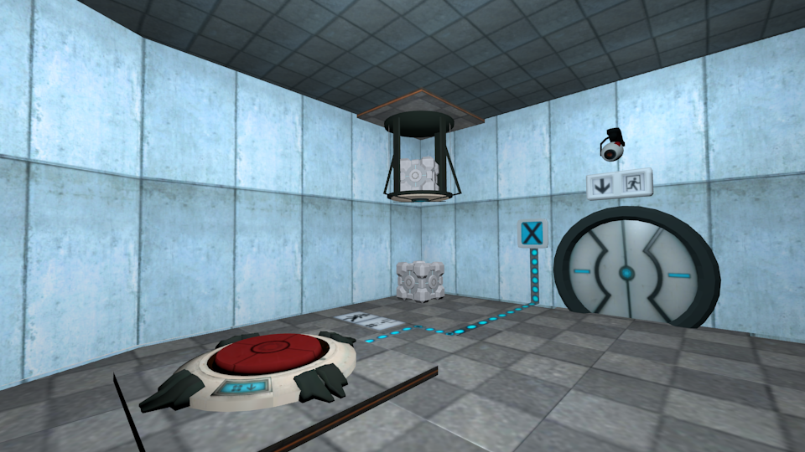
Mounting hook
Resistant Coating
Access Panel
Case
Battery
Motor
Chip / Board
Strip Supply/Loader
LED
Optical Sensor
Wireless Transmitter
In-home device
Strips/Testing Chemicals
Testing Chamber
Intake Pump
Toilet Water
Filter

Slide 13
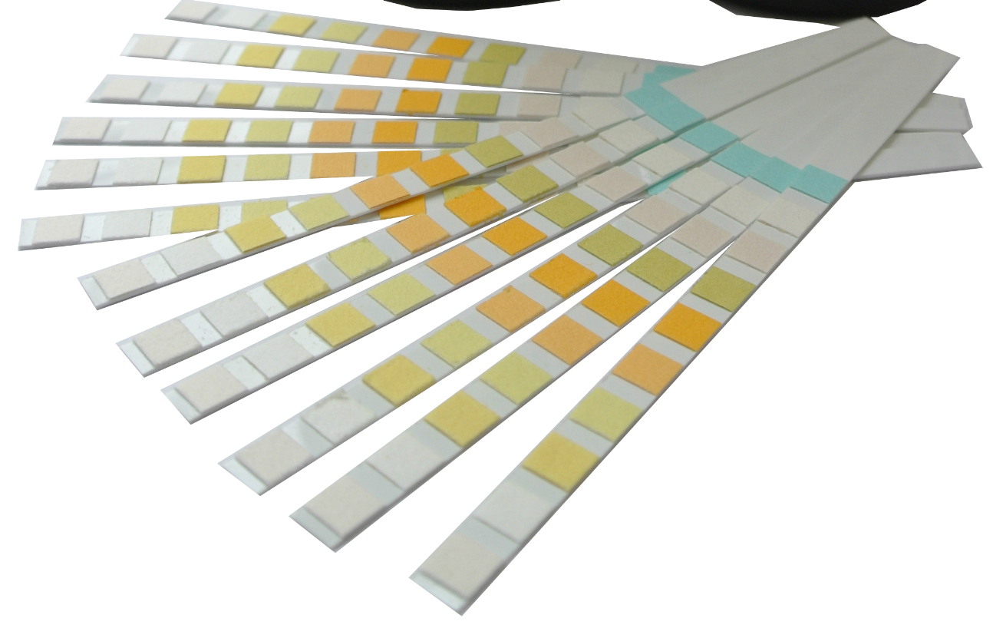
Mounting hook
Resistant Coating
Access Panel
Case
Battery
Motor
Chip / Board
Strip Supply/Loader
LED
Optical Sensor
Wireless Transmitter
In-home device
Strips/Testing Chemicals
Testing Chamber
Intake Pump
Toilet Water
Filter

Slide 14
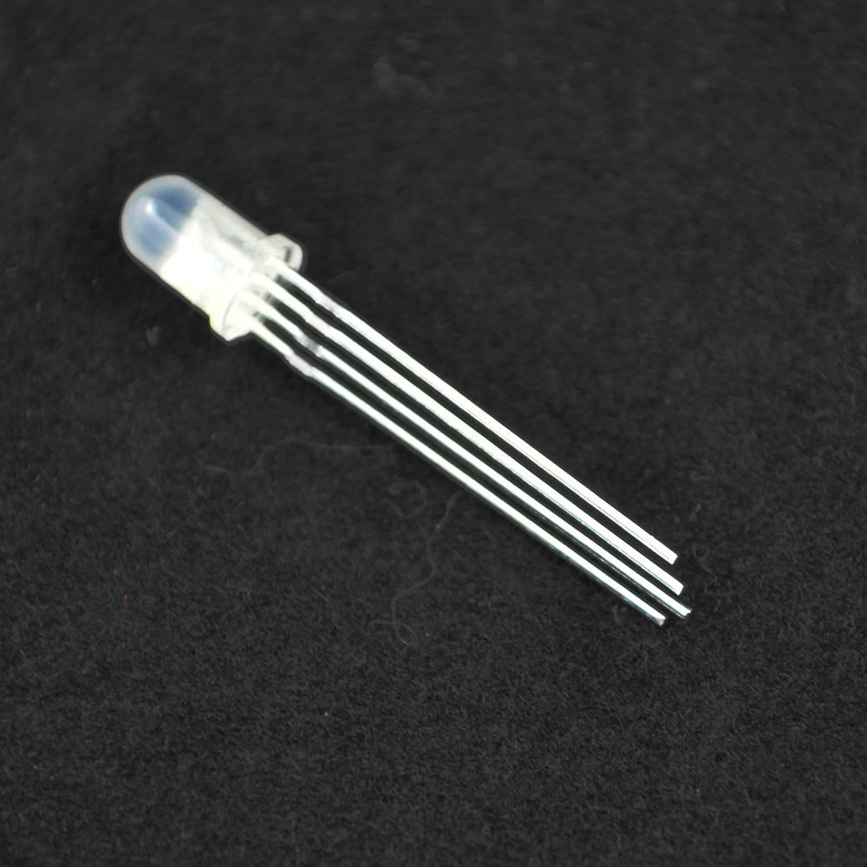
Mounting hook
Resistant Coating
Access Panel
Case
Battery
Motor
Chip / Board
Strip Supply/Loader
LED
Optical Sensor
Wireless Transmitter
In-home device
Strips/Testing Chemicals
Testing Chamber
Intake Pump
Toilet Water
Filter

Slide 15
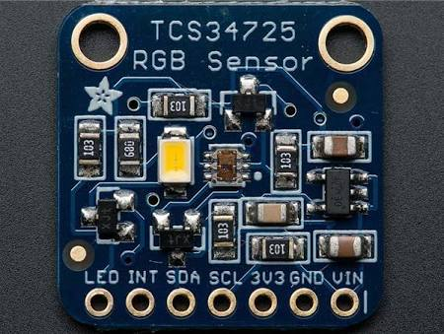
Mounting hook
Resistant Coating
Access Panel
Case
Battery
Motor
Chip / Board
Strip Supply/Loader
LED
Optical Sensor
Wireless Transmitter
In-home device
Strips/Testing Chemicals
Testing Chamber
Intake Pump
Toilet Water
Filter

Slide 16
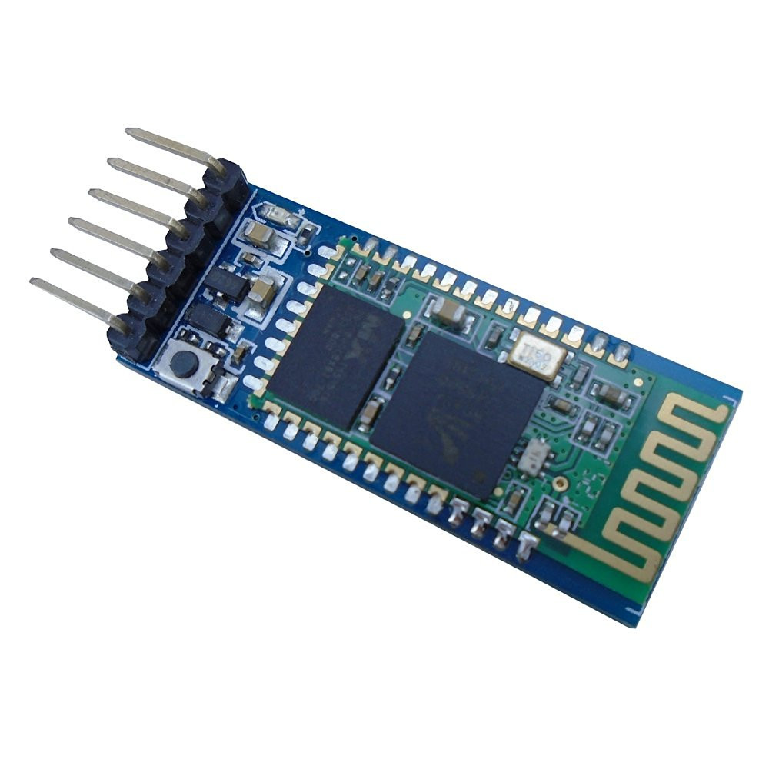
Mounting hook
Resistant Coating
Access Panel
Case
Battery
Motor
Chip / Board
Strip Supply/Loader
LED
Optical Sensor
Wireless Transmitter
In-home device
Strips/Testing Chemicals
Testing Chamber
Intake Pump
Toilet Water
Filter

Slide 17

Mounting hook
Resistant Coating
Access Panel
Case
Battery
Motor
Chip / Board
Strip Supply/Loader
LED
Optical Sensor
Wireless Transmitter
In-home device
Strips/Testing Chemicals
Testing Chamber
Intake Pump
Toilet Water
Filter

Slide 18


Our Journey
Make insurance feel predictive, proactive, and supportive.
Transform healthcare with widespread, frictionless symptom detection

Slide 19
Thank You!
Andrew Doberstein - acd75@cornell.edu
Abhiram Muddu - vm332@cornell.edu
Jimmy Ma - ym423@cornell.edu
Utsav Vakil - uuv2@cornell.edu

Slide 20
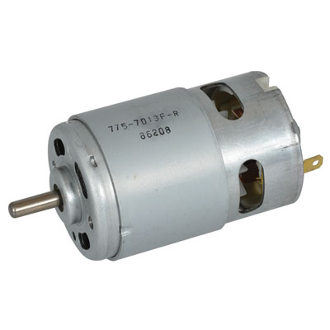
Mounting hook
Resistant Coating
Access Panel
Case
Battery
Motor
Chip / Board
Strip Supply/Loader
LED
Optical Sensor
Wireless Transmitter
In-home device
Strips/Testing Chemicals
Testing Chamber
Intake Pump
Toilet Water
Filter

Slide 21



Key Insights:
Build a solution that goes beyond the standard 3 conversations that Insurance companies have with their users and engage them better.

Slide 22
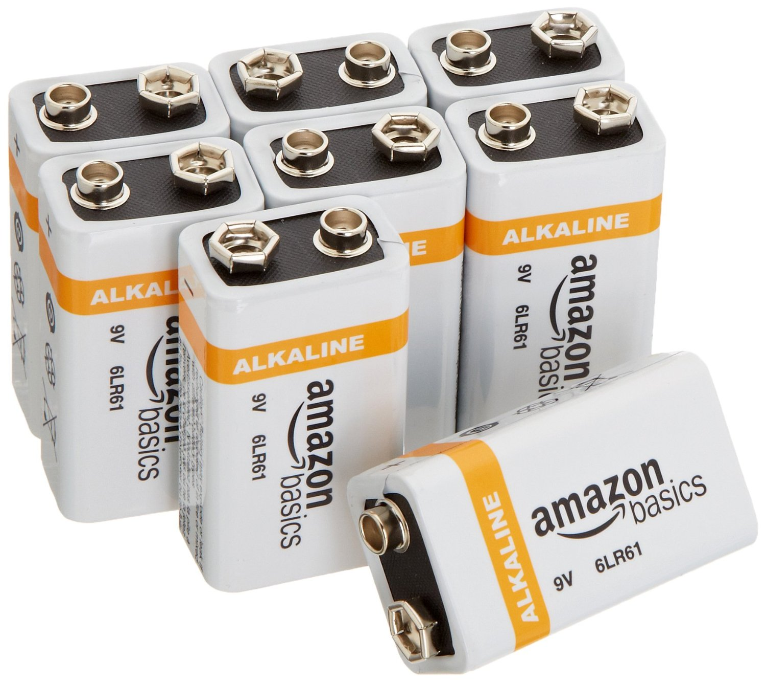
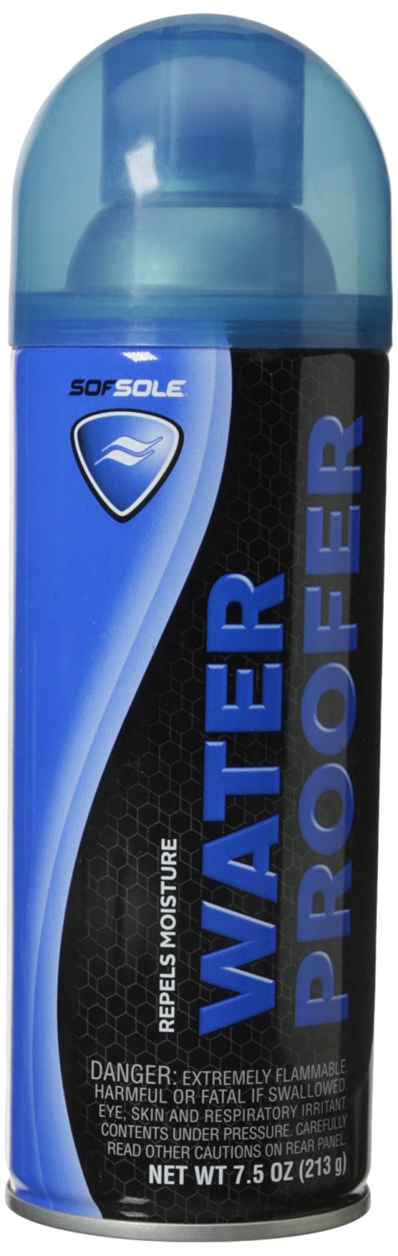
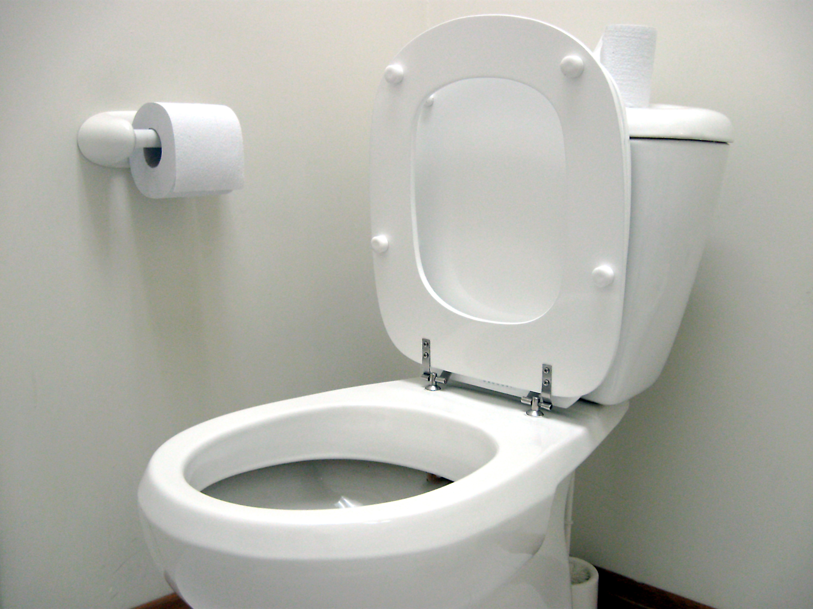
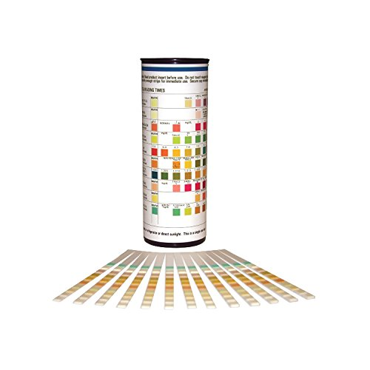
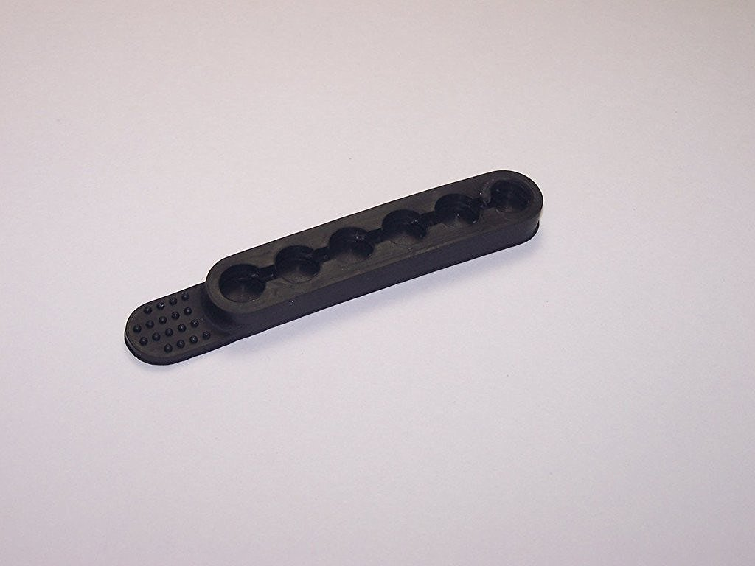

Slide 23
Strip Loader
https://www.amazon.com/Bullet-Strip-Caliber-Rounds-SHIPPING/dp/B01EAXYBLG/ref=sr_1_1?s=sporting-goods&ie=UTF8&qid=1474644906&sr=1-1&keywords=strip+loader

Slide 24
Neverwet
https://www.amazon.com/Sof-Sole-Water-Proofer-5-Ounce/dp/B003IJ6R0W/ref=sr_1_2?s=sporting-goods&ie=UTF8&qid=1474645042&sr=1-2&keywords=neverwet

Slide 25
RC Motor
http://www.jameco.com/z/775-7013F-R-Nichibo-Taiwan-12VDC-Motor-12-610-RPM_2210845.html?CID=GOOG&gclid=Cj0KEQjwpZO_BRDym6K_nMye7cEBEiQAVA7RaPnN5adQu4X29K82ejpbaa6VlTUQtAj1hM5RcatDAn8aAg7P8P8HAQ
http://www.jameco.com/z/775-7013F-R-Nichibo-Taiwan-12VDC-Motor-12-610-RPM_2210845.html?CID=GOOG&gclid=Cj0KEQjwpZO_BRDym6K_nMye7cEBEiQAVA7RaPnN5adQu4X29K82ejpbaa6VlTUQtAj1hM5RcatDAn8aAg7P8P8HAQ

Slide 26
Battery
https://www.amazon.com/AmazonBasics-Everyday-Alkaline-Batteries-8-Pack/dp/B00MH4QM1S/ref=sr_1_3_a_it?ie=UTF8&qid=1474645412&sr=8-3&keywords=battery+9v

Slide 27
Bluetooth
https://www.amazon.com/DSD-TECH-Bluetooth-Pass-through-Communication/dp/B01G9KSAF6/ref=sr_1_1?ie=UTF8&qid=1474647032&sr=8-1&keywords=hc05

Slide 28
LED
https://www.amazon.com/SODIAL-Common-Cathode-Emitting-Diodes/dp/B00F4MGA0I/ref=sr_1_3?s=electronics&ie=UTF8&qid=1474645807&sr=1-3&keywords=luminous+diode

Slide 29
Optical Sensor
https://www.google.com/webhp?sourceid=chrome-instant&ion=1&espv=2&ie=UTF-8#q=optical+rgb+sensor+part&newwindow=1&safe=off&tbm=shop&spd=17428184746334688767

Slide 30
Chip
https://www.amazon.com/Arduino-Uno-R3-Microcontroller-A000066/dp/B008GRTSV6/ref=sr_1_1?s=pc&ie=UTF8&qid=1474647486&sr=8-1&keywords=arduino+un

Slide 31
Intake Pump
https://www.amazon.com/Homasy-Submersible-Aquarium-Fountain-Hydroponics/dp/B00EWENMAU/ref=sr_1_1?ie=UTF8&qid=1474646811&sr=8-1-spons&keywords=aquarium+water+pump&psc=1

Slide 32
Testing chemicals
https://www.amazon.com/Parameter-Urinalysis-Reagent-Strips-strips/dp/B01IPEDNIS/ref=sr_tnr_p_3_industrial_1_s_it?s=hpc&ie=UTF8&qid=1474642788&sr=1-3

Slide 33
reloadable access chamber

Slide 34
System Diagram & Wedges
Suggest the cost could be subsidized/covered by insurance
Mention reduced premium?
Cover key insights [Three conversations]
Cover wedges [Convenience]
Emphasize benefits to insurance companies here
Healthier relationship
Reduced claims
Data can be used for prediction

Slide 35
Mounting Hook

